Slide 1
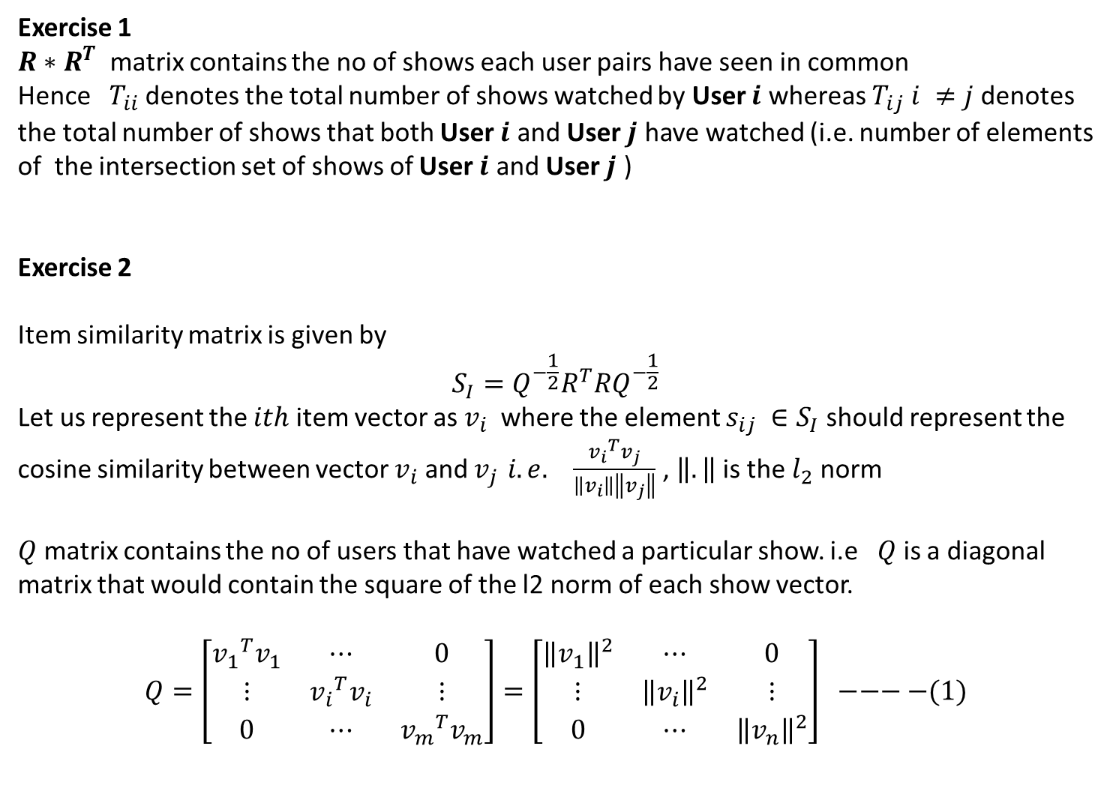
Exercise 1
$R∗R^{T}$ matrix contains the no of shows each user pairs have seen in common
Hence $T_{ii}$denotes the total number of shows watched by User $i$ whereas $T_{ij} i ≠j$denotes the total number of shows that both User $i$ and User $j$ have watched (i.e. number of elements of the intersection set of shows of User $i$ and User $j$ )
Exercise 2
Item similarity matrix is given by
$$S_{I}=Q^{−\frac{1}{2}}R^{T}RQ^{−\frac{1}{2}}$$
Let us represent the $ith$ item vector as $v_{i}$ where the element $s_{ij} ∈S_{I}$should represent the cosine similarity between vector $v_{i}$ and $v_{j }i.e.$ $\frac{{v_{i}}^{T}v_{j}}{\left\|v_{i}\right\|\left\|v_{j}\right\|}$ , $\left\|.\right\|$ is the $l_{2}$ norm
$Q$ matrix contains the no of users that have watched a particular show. i.e $Q$ is a diagonal matrix that would contain the square of the l2 norm of each show vector.
$$Q=\left[\begin{matrix}{v_{1}}^{T}v_{1} & ⋯ & 0 \\ ⋮ & {v_{i}}^{T}v_{i} & ⋮ \\ 0 & ⋯ & {v_{m}}^{T}v_{m}\end{matrix}\right]=\left[\begin{matrix}{\left\|v_{1}\right\|}^{2} & ⋯ & 0 \\ ⋮ & {\left\|v_{i}\right\|}^{2} & ⋮ \\ 0 & ⋯ & {\left\|v_{n}\right\|}^{2}\end{matrix}\right] −−−−(1)$$

Slide 2
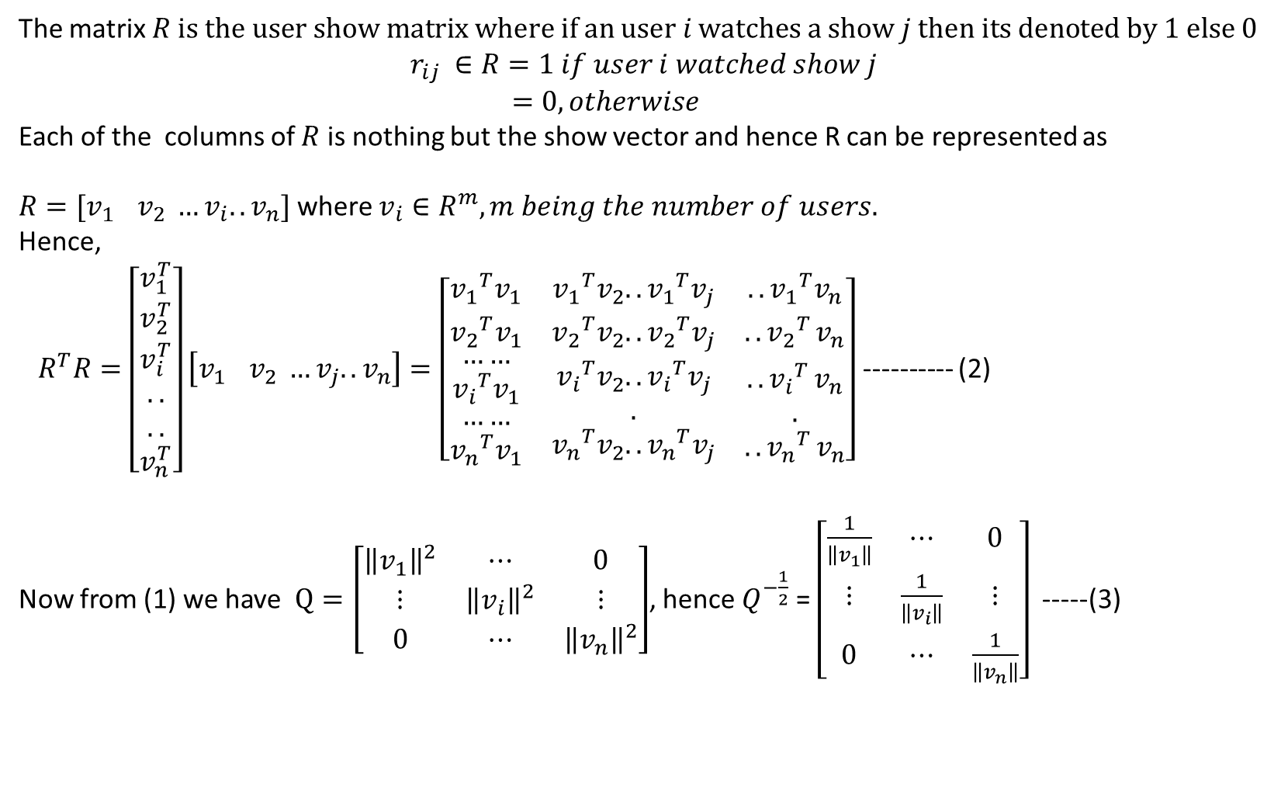
The matrix $R is the user show matrix where if an user i watches a show j then its denoted by 1 else 0$
$$r_{ij} ∈R=1 if user i watched show j$$
$=0, otherwise$
Each of the columns of $R$ is nothing but the show vector and hence R can be represented as
$R=[v_{1 } v_{2} …v_{i}..v_{n}]$ where $v_{i}∈R^{m}, m being the number of users.$
Hence,
${ R}^{T}R=\left[\begin{matrix}v_{1}^{T} \\ v_{2}^{T} \\ \begin{aligned}v_{i}^{T} \\ .. \\ .. \\ v_{n}^{T}\end{aligned}\end{matrix}\right]\left[v_{1 } v_{2} …v_{j}..v_{n}\right]=\left[\begin{matrix}{v_{1}}^{T}v_{1} & {v_{1}}^{T}v_{2}..{v_{1}}^{T}v_{j} & ..{v_{1}}^{T}v_{n} \\ {v_{2}}^{T}v_{1} & {v_{2}}^{T}v_{2}..{v_{2}}^{T}v_{j} & {{..v}_{2}}^{T}v_{n} \\ \begin{aligned}\begin{aligned}…… \\ {v_{i}}^{T}v_{1}\end{aligned} \\ …… \\ {v_{n}}^{T}v_{1}\end{aligned} & \begin{aligned}{v_{i}}^{T}v_{2}..{v_{i}}^{T}v_{j} \\ . \\ {v_{n}}^{T}v_{2}..{v_{n}}^{T}v_{j}\end{aligned} & \begin{aligned}{{..v}_{i}}^{T}v_{n} \\ . \\ {{..v}_{n}}^{T}v_{n}\end{aligned}\end{matrix}\right]$ ---------- (2)
Now from (1) we have $Q=\left[\begin{matrix}{\left\|v_{1}\right\|}^{2} & ⋯ & 0 \\ ⋮ & {\left\|v_{i}\right\|}^{2} & ⋮ \\ 0 & ⋯ & {\left\|v_{n}\right\|}^{2}\end{matrix}\right]$, hence $Q^{−\frac{1}{2}}$ = $\left[\begin{matrix}\frac{1}{\left\|v_{1}\right\|} & ⋯ & 0 \\ ⋮ & \frac{1}{\left\|v_{i}\right\|} & ⋮ \\ 0 & ⋯ & \frac{1}{\left\|v_{n}\right\|}\end{matrix}\right]$ -----(3)

Slide 3
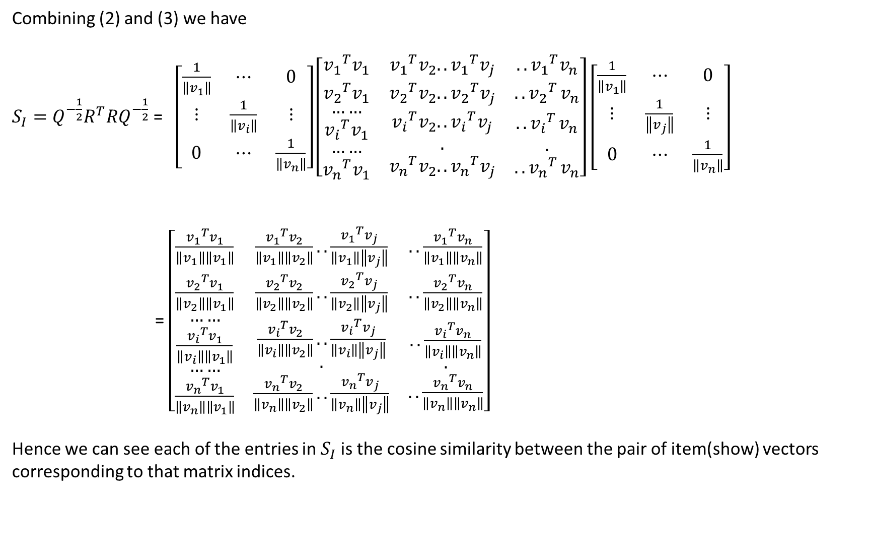
Combining (2) and (3) we have
$S_{I}=Q^{−\frac{1}{2}}R^{T}RQ^{−\frac{1}{2}}$ = $\left[\begin{matrix}\frac{1}{\left\|v_{1}\right\|} & ⋯ & 0 \\ ⋮ & \frac{1}{\left\|v_{i}\right\|} & ⋮ \\ 0 & ⋯ & \frac{1}{\left\|v_{n}\right\|}\end{matrix}\right]\left[\begin{matrix}{v_{1}}^{T}v_{1} & {v_{1}}^{T}v_{2}..{v_{1}}^{T}v_{j} & ..{v_{1}}^{T}v_{n} \\ {v_{2}}^{T}v_{1} & {v_{2}}^{T}v_{2}..{v_{2}}^{T}v_{j} & {{..v}_{2}}^{T}v_{n} \\ \begin{aligned}\begin{aligned}…… \\ {v_{i}}^{T}v_{1}\end{aligned} \\ …… \\ {v_{n}}^{T}v_{1}\end{aligned} & \begin{aligned}{v_{i}}^{T}v_{2}..{v_{i}}^{T}v_{j} \\ . \\ {v_{n}}^{T}v_{2}..{v_{n}}^{T}v_{j}\end{aligned} & \begin{aligned}{{..v}_{i}}^{T}v_{n} \\ . \\ {{..v}_{n}}^{T}v_{n}\end{aligned}\end{matrix}\right]$ $\left[\begin{matrix}\frac{1}{\left\|v_{1}\right\|} & ⋯ & 0 \\ ⋮ & \frac{1}{\left\|v_{j}\right\|} & ⋮ \\ 0 & ⋯ & \frac{1}{\left\|v_{n}\right\|}\end{matrix}\right]$
= $\left[\begin{matrix}\frac{{v_{1}}^{T}v_{1}}{\left\|v_{1}\right\|\left\|v_{1}\right\|} & \frac{{v_{1}}^{T}v_{2}}{\left\|v_{1}\right\|\left\|v_{2}\right\|}..\frac{{v_{1}}^{T}v_{j}}{\left\|v_{1}\right\|\left\|v_{j}\right\|} & ..\frac{{v_{1}}^{T}v_{n}}{\left\|v_{1}\right\|\left\|v_{n}\right\|} \\ \frac{{v_{2}}^{T}v_{1}}{\left\|v_{2}\right\|\left\|v_{1}\right\|} & \frac{{v_{2}}^{T}v_{2}}{\left\|v_{2}\right\|\left\|v_{2}\right\|}..\frac{{v_{2}}^{T}v_{j}}{\left\|v_{2}\right\|\left\|v_{j}\right\|} & ..\frac{{v_{2}}^{T}v_{n}}{\left\|v_{2}\right\|\left\|v_{n}\right\|} \\ \begin{aligned}\begin{aligned}…… \\ \frac{{v_{i}}^{T}v_{1}}{\left\|v_{i}\right\|\left\|v_{1}\right\|}\end{aligned} \\ …… \\ \frac{{v_{n}}^{T}v_{1}}{\left\|v_{n}\right\|\left\|v_{1}\right\|}\end{aligned} & \begin{aligned}\frac{{v_{i}}^{T}v_{2}}{\left\|v_{i}\right\|\left\|v_{2}\right\|}..\frac{{v_{i}}^{T}v_{j}}{\left\|v_{i}\right\|\left\|v_{j}\right\|} \\ . \\ \frac{{v_{n}}^{T}v_{2}}{\left\|v_{n}\right\|\left\|v_{2}\right\|}..\frac{{v_{n}}^{T}v_{j}}{\left\|v_{n}\right\|\left\|v_{j}\right\|}\end{aligned} & \begin{aligned}..\frac{{v_{i}}^{T}v_{n}}{\left\|v_{i}\right\|\left\|v_{n}\right\|} \\ . \\ ..\frac{{v_{n}}^{T}v_{n}}{\left\|v_{n}\right\|\left\|v_{n}\right\|}\end{aligned}\end{matrix}\right]$
Hence we can see each of the entries in $S_{I}$is the cosine similarity between the pair of item(show) vectors corresponding to that matrix indices.

Slide 4
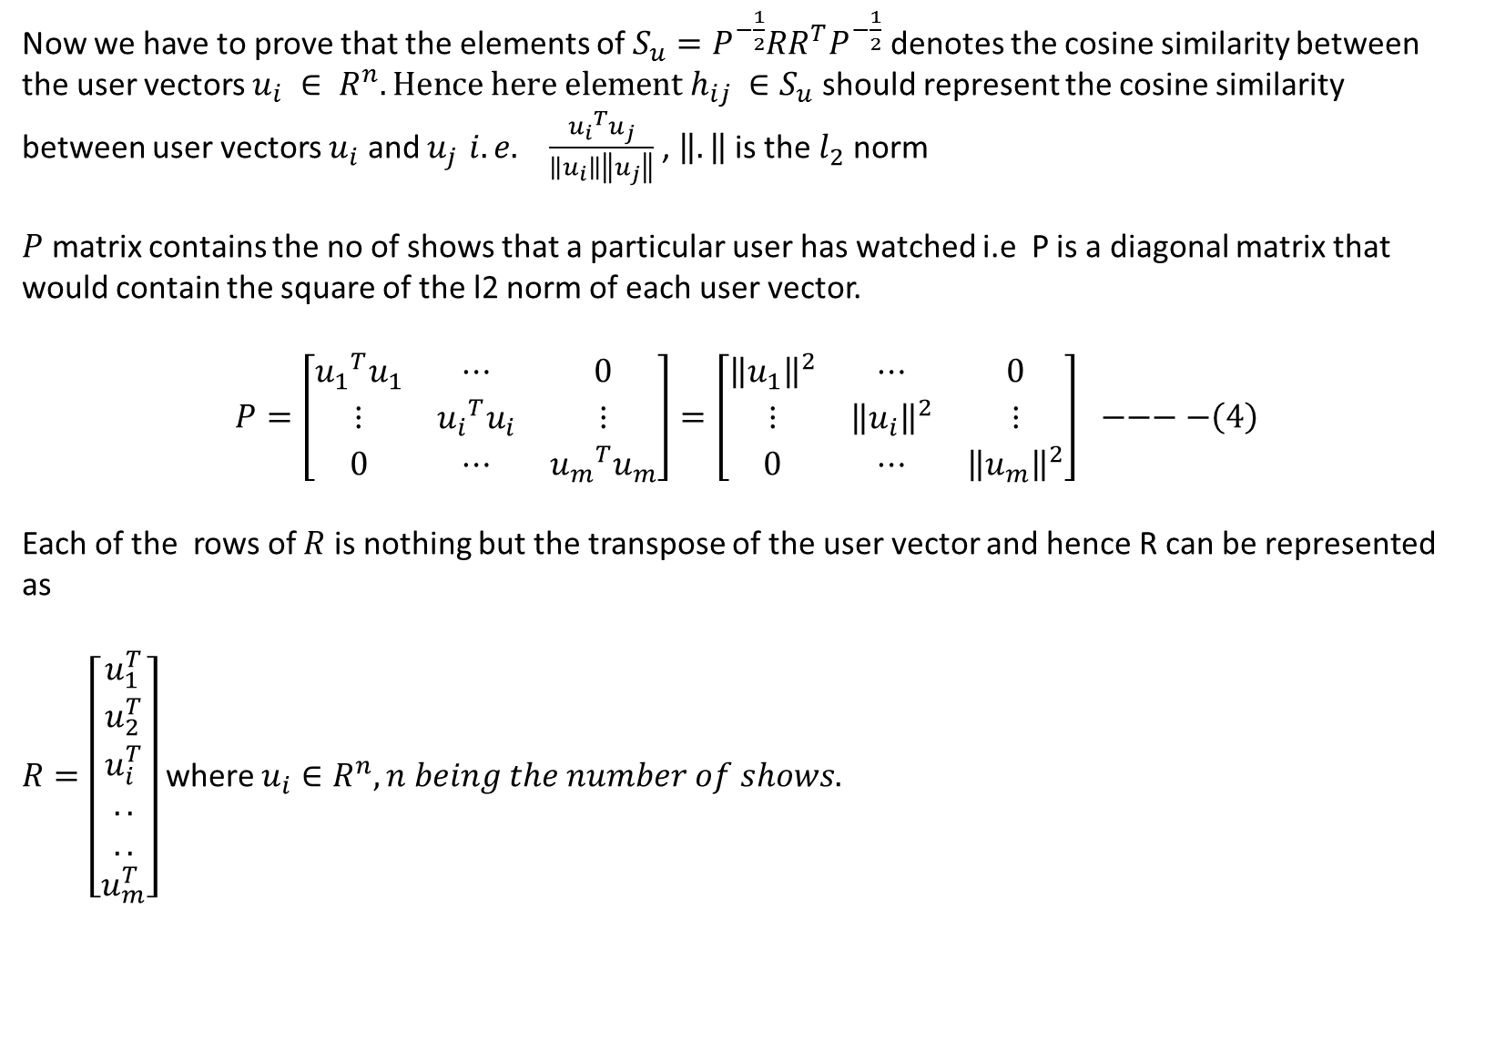
Now we have to prove that the elements of $S_{u}=P^{−\frac{1}{2}}RR^{T}P^{−\frac{1}{2}}$ denotes the cosine similarity between the user vectors $u_{i} ∈ R^{n}. Hence here element h_{ij} ∈S_{u}$ should represent the cosine similarity between user vectors $u_{i}$ and $u_{j }i.e.$ $\frac{{u_{i}}^{T}u_{j}}{\left\|u_{i}\right\|\left\|u_{j}\right\|}$ , $\left\|.\right\|$ is the $l_{2}$ norm
$P$ matrix contains the no of shows that a particular user has watched i.e P is a diagonal matrix that would contain the square of the l2 norm of each user vector.
$$P=\left[\begin{matrix}{u_{1}}^{T}u_{1} & ⋯ & 0 \\ ⋮ & {u_{i}}^{T}u_{i} & ⋮ \\ 0 & ⋯ & {u_{m}}^{T}u_{m}\end{matrix}\right]=\left[\begin{matrix}{\left\|u_{1}\right\|}^{2} & ⋯ & 0 \\ ⋮ & {\left\|u_{i}\right\|}^{2} & ⋮ \\ 0 & ⋯ & {\left\|u_{m}\right\|}^{2}\end{matrix}\right] −−−−\left(4\right)$$
Each of the rows of $R$ is nothing but the transpose of the user vector and hence R can be represented as
$R=\left[\begin{matrix}u_{1}^{T} \\ u_{2}^{T} \\ \begin{aligned}u_{i}^{T} \\ .. \\ .. \\ u_{m}^{T}\end{aligned}\end{matrix}\right]$ where $u_{i}∈R^{n}, n being the number of shows.$

Slide 5
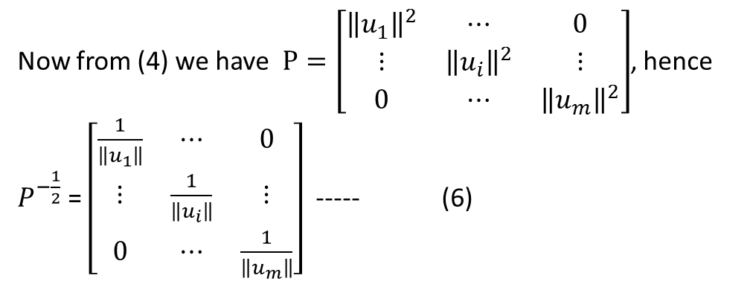
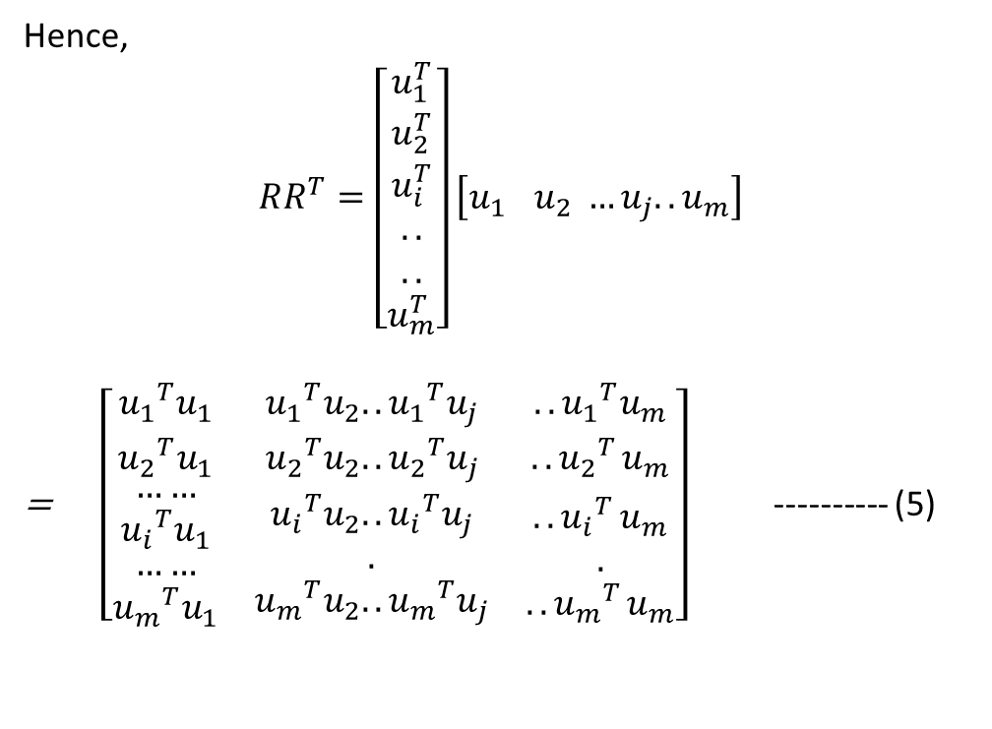
Hence,
$$RR^{T}=\left[\begin{matrix}u_{1}^{T} \\ u_{2}^{T} \\ \begin{aligned}u_{i}^{T} \\ .. \\ .. \\ u_{m}^{T}\end{aligned}\end{matrix}\right]\left[u_{1 } u_{2} …u_{j}..u_{m}\right]$$
= $\left[\begin{matrix}{u_{1}}^{T}u_{1} & {u_{1}}^{T}u_{2}..{u_{1}}^{T}u_{j} & ..{u_{1}}^{T}u_{m} \\ {u_{2}}^{T}u_{1} & {u_{2}}^{T}u_{2}..{u_{2}}^{T}u_{j} & {{..u}_{2}}^{T}u_{m} \\ \begin{aligned}\begin{aligned}…… \\ {u_{i}}^{T}u_{1}\end{aligned} \\ …… \\ {u_{m}}^{T}u_{1}\end{aligned} & \begin{aligned}{u_{i}}^{T}u_{2}..{u_{i}}^{T}u_{j} \\ . \\ {u_{m}}^{T}u_{2}..{u_{m}}^{T}u_{j}\end{aligned} & \begin{aligned}{{..u}_{i}}^{T}u_{m} \\ . \\ {{..u}_{m}}^{T}u_{m}\end{aligned}\end{matrix}\right]$ ---------- (5)
Now from (4) we have $P=\left[\begin{matrix}{\left\|u_{1}\right\|}^{2} & ⋯ & 0 \\ ⋮ & {\left\|u_{i}\right\|}^{2} & ⋮ \\ 0 & ⋯ & {\left\|u_{m}\right\|}^{2}\end{matrix}\right]$, hence $P^{−\frac{1}{2}}$ = $\left[\begin{matrix}\frac{1}{\left\|u_{1}\right\|} & ⋯ & 0 \\ ⋮ & \frac{1}{\left\|u_{i}\right\|} & ⋮ \\ 0 & ⋯ & \frac{1}{\left\|u_{m}\right\|}\end{matrix}\right]$ ----- (6)

Slide 6
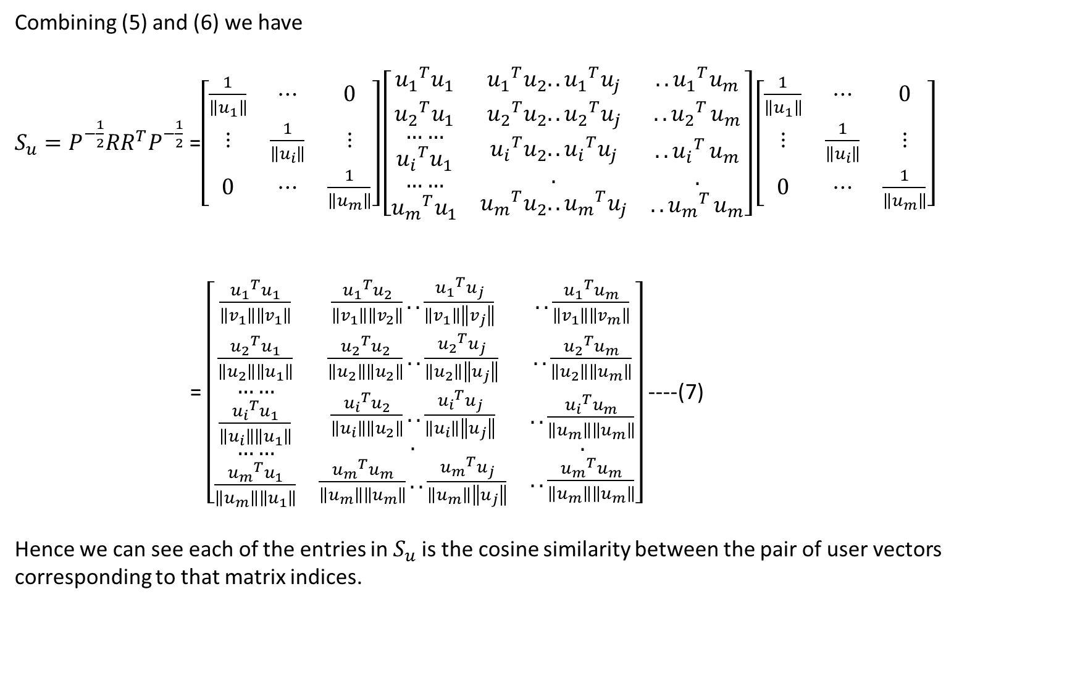
Combining (5) and (6) we have
$S_{u}=P^{−\frac{1}{2}}RR^{T}P^{−\frac{1}{2}}$ =$\left[\begin{matrix}\frac{1}{\left\|u_{1}\right\|} & ⋯ & 0 \\ ⋮ & \frac{1}{\left\|u_{i}\right\|} & ⋮ \\ 0 & ⋯ & \frac{1}{\left\|u_{m}\right\|}\end{matrix}\right]\left[\begin{matrix}{u_{1}}^{T}u_{1} & {u_{1}}^{T}u_{2}..{u_{1}}^{T}u_{j} & ..{u_{1}}^{T}u_{m} \\ {u_{2}}^{T}u_{1} & {u_{2}}^{T}u_{2}..{u_{2}}^{T}u_{j} & {{..u}_{2}}^{T}u_{m} \\ \begin{aligned}\begin{aligned}…… \\ {u_{i}}^{T}u_{1}\end{aligned} \\ …… \\ {u_{m}}^{T}u_{1}\end{aligned} & \begin{aligned}{u_{i}}^{T}u_{2}..{u_{i}}^{T}u_{j} \\ . \\ {u_{m}}^{T}u_{2}..{u_{m}}^{T}u_{j}\end{aligned} & \begin{aligned}{{..u}_{i}}^{T}u_{m} \\ . \\ {{..u}_{m}}^{T}u_{m}\end{aligned}\end{matrix}\right]\left[\begin{matrix}\frac{1}{\left\|u_{1}\right\|} & ⋯ & 0 \\ ⋮ & \frac{1}{\left\|u_{i}\right\|} & ⋮ \\ 0 & ⋯ & \frac{1}{\left\|u_{m}\right\|}\end{matrix}\right]$
= $\left[\begin{matrix}\frac{{u_{1}}^{T}u_{1}}{\left\|v_{1}\right\|\left\|v_{1}\right\|} & \frac{{u_{1}}^{T}u_{2}}{\left\|v_{1}\right\|\left\|v_{2}\right\|}..\frac{{u_{1}}^{T}u_{j}}{\left\|v_{1}\right\|\left\|v_{j}\right\|} & ..\frac{{u_{1}}^{T}u_{m}}{\left\|v_{1}\right\|\left\|v_{m}\right\|} \\ \frac{{u_{2}}^{T}u_{1}}{\left\|u_{2}\right\|\left\|u_{1}\right\|} & \frac{{u_{2}}^{T}u_{2}}{\left\|u_{2}\right\|\left\|u_{2}\right\|}..\frac{{u_{2}}^{T}u_{j}}{\left\|u_{2}\right\|\left\|u_{j}\right\|} & ..\frac{{u_{2}}^{T}u_{m}}{\left\|u_{2}\right\|\left\|u_{m}\right\|} \\ \begin{aligned}\begin{aligned}…… \\ \frac{{u_{i}}^{T}u_{1}}{\left\|u_{i}\right\|\left\|u_{1}\right\|}\end{aligned} \\ …… \\ \frac{{u_{m}}^{T}u_{1}}{\left\|u_{m}\right\|\left\|u_{1}\right\|}\end{aligned} & \begin{aligned}\frac{{u_{i}}^{T}u_{2}}{\left\|u_{i}\right\|\left\|u_{2}\right\|}..\frac{{u_{i}}^{T}u_{j}}{\left\|u_{i}\right\|\left\|u_{j}\right\|} \\ . \\ \frac{{u_{m}}^{T}u_{m}}{\left\|u_{m}\right\|\left\|u_{m}\right\|}..\frac{{u_{m}}^{T}u_{j}}{\left\|u_{m}\right\|\left\|u_{j}\right\|}\end{aligned} & \begin{aligned}..\frac{{u_{i}}^{T}u_{m}}{\left\|u_{m}\right\|\left\|u_{m}\right\|} \\ . \\ ..\frac{{u_{m}}^{T}u_{m}}{\left\|u_{m}\right\|\left\|u_{m}\right\|}\end{aligned}\end{matrix}\right]$ ----(7)
Hence we can see each of the entries in $S_{u}$is the cosine similarity between the pair of user vectors corresponding to that matrix indices.

Slide 7

The same expressions would have held true if we have rating 1-5 since the expressions $S_{u} andS_{I}$would still have yielded the cosine similarity matrices.
Please move to the next page

Slide 8
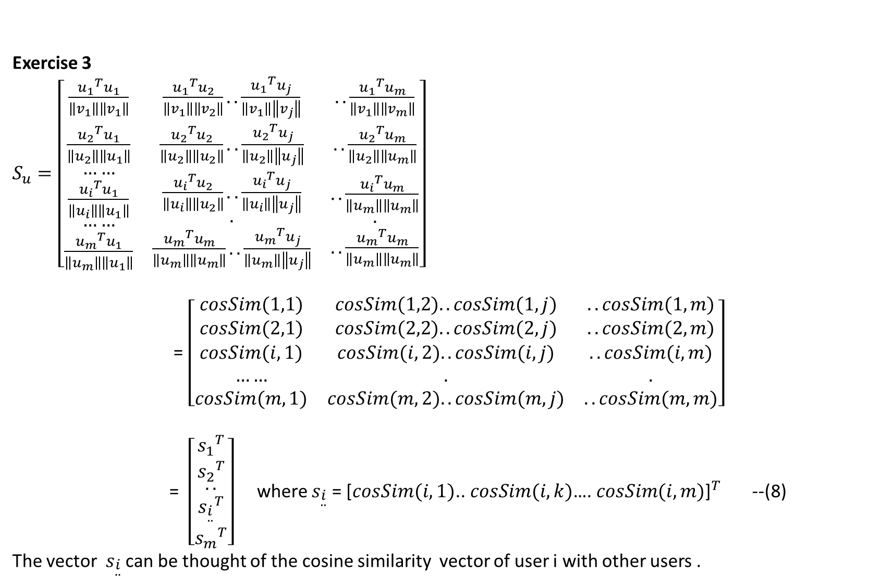
Exercise 3
$S_{u}=\left[\begin{matrix}\frac{{u_{1}}^{T}u_{1}}{\left\|v_{1}\right\|\left\|v_{1}\right\|} & \frac{{u_{1}}^{T}u_{2}}{\left\|v_{1}\right\|\left\|v_{2}\right\|}..\frac{{u_{1}}^{T}u_{j}}{\left\|v_{1}\right\|\left\|v_{j}\right\|} & ..\frac{{u_{1}}^{T}u_{m}}{\left\|v_{1}\right\|\left\|v_{m}\right\|} \\ \frac{{u_{2}}^{T}u_{1}}{\left\|u_{2}\right\|\left\|u_{1}\right\|} & \frac{{u_{2}}^{T}u_{2}}{\left\|u_{2}\right\|\left\|u_{2}\right\|}..\frac{{u_{2}}^{T}u_{j}}{\left\|u_{2}\right\|\left\|u_{j}\right\|} & ..\frac{{u_{2}}^{T}u_{m}}{\left\|u_{2}\right\|\left\|u_{m}\right\|} \\ \begin{aligned}\begin{aligned}…… \\ \frac{{u_{i}}^{T}u_{1}}{\left\|u_{i}\right\|\left\|u_{1}\right\|}\end{aligned} \\ …… \\ \frac{{u_{m}}^{T}u_{1}}{\left\|u_{m}\right\|\left\|u_{1}\right\|}\end{aligned} & \begin{aligned}\frac{{u_{i}}^{T}u_{2}}{\left\|u_{i}\right\|\left\|u_{2}\right\|}..\frac{{u_{i}}^{T}u_{j}}{\left\|u_{i}\right\|\left\|u_{j}\right\|} \\ . \\ \frac{{u_{m}}^{T}u_{m}}{\left\|u_{m}\right\|\left\|u_{m}\right\|}..\frac{{u_{m}}^{T}u_{j}}{\left\|u_{m}\right\|\left\|u_{j}\right\|}\end{aligned} & \begin{aligned}..\frac{{u_{i}}^{T}u_{m}}{\left\|u_{m}\right\|\left\|u_{m}\right\|} \\ . \\ ..\frac{{u_{m}}^{T}u_{m}}{\left\|u_{m}\right\|\left\|u_{m}\right\|}\end{aligned}\end{matrix}\right]$
= $\left[\begin{matrix}cosSim(1,1) & cosSim(1,2)..cosSim(1,j) & ..cosSim(1,m) \\ cosSim(2,1) & cosSim(2,2)..cosSim(2,j) & ..cosSim(2,m) \\ \begin{aligned}cosSim(i,1) \\ …… \\ cosSim(m,1)\end{aligned} & \begin{aligned}cosSim(i,2)..cosSim(i,j) \\ . \\ cosSim(m,2)..cosSim(m,j)\end{aligned} & \begin{aligned}..cosSim(i,m) \\ . \\ ..cosSim(m,m)\end{aligned}\end{matrix}\right]$
= $\left[\begin{matrix}{s_{1}}^{T} \\ {s_{2}}^{T} \\ \begin{aligned}\begin{aligned}.. \\ {s_{\begin{aligned}i \\ ..\end{aligned}}}^{T}\end{aligned} \\ {s_{m}}^{T}\end{aligned}\end{matrix}\right]$ where $s_{\begin{aligned}i \\ ..\end{aligned}}$ = ${\text{[}cosSim(i,1)\text{.. }cosSim(i,k)\text{….} cosSim(i,m)\text{]}}^{T}$ --(8)
The vector $s_{\begin{aligned}i \\ ..\end{aligned}}$ can be thought of the cosine similarity vector of user i with other users .

Slide 9
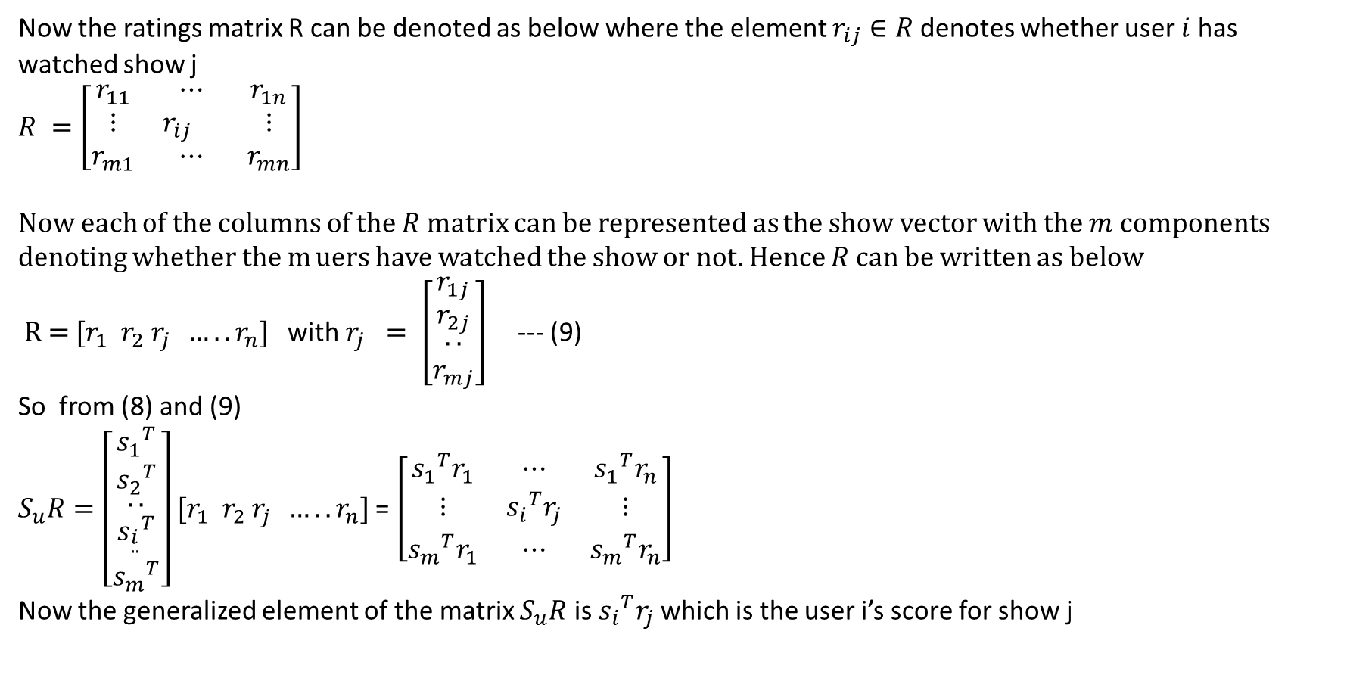
Now the ratings matrix R can be denoted as below where the element $r_{ij}∈R$denotes whether user $i$ has watched show j
$R =\left[\begin{matrix}r_{11} & ⋯ & r_{1n} \\ ⋮ & r_{ij } & ⋮ \\ r_{m1} & ⋯ & r_{mn}\end{matrix}\right]$
Now each of the columns of the $R$ matrix can be represented as the show vector with the $m$ components denoting whether the m uers have watched the show or not. Hence $R$ can be written as below
R = $[r_{1}{ r}_{2}$ $r_{j} …..r_{n}]$ with $r_{j} = \left[\begin{matrix}r_{1j} \\ r_{2j} \\ \begin{aligned}.. \\ r_{mj}\end{aligned}\end{matrix}\right]$ --- (9)
So from (8) and (9)
$S_{u}R=\left[\begin{matrix}{s_{1}}^{T} \\ {s_{2}}^{T} \\ \begin{aligned}\begin{aligned}.. \\ {s_{\begin{aligned}i \\ ..\end{aligned}}}^{T}\end{aligned} \\ {s_{m}}^{T}\end{aligned}\end{matrix}\right]$ $[r_{1}{ r}_{2}$ $r_{j} …..r_{n}]$= $\left[\begin{matrix}{s_{1}}^{T}r_{1} & ⋯ & {s_{1}}^{T}r_{n} \\ ⋮ & {s_{i}}^{T}r_{j} & ⋮ \\ {s_{m}}^{T}r_{1} & ⋯ & {s_{m}}^{T}r_{n}\end{matrix}\right]$
Now the generalized element of the matrix $S_{u}R$ is ${s_{i}}^{T}r_{j}$ which is the user i’s score for show j

Slide 10
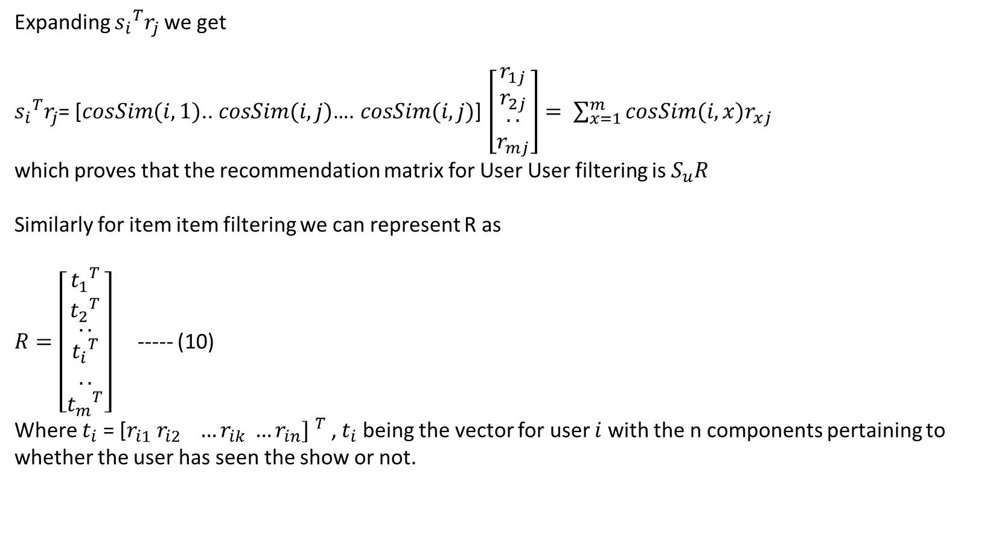
Expanding ${s_{i}}^{T}r_{j}$ we get
${s_{i}}^{T}r_{j}$= $\text{[}cosSim(i,1)\text{.. }cosSim(i,j)\text{….} cosSim(i,j)\text{]}$ $\left[\begin{matrix}r_{1j} \\ r_{2j} \\ \begin{aligned}.. \\ r_{mj}\end{aligned}\end{matrix}\right]= \sum_{x=1}^{m}{cosSim(i,x)r_{xj}}$
which proves that the recommendation matrix for User User filtering is $S_{u}R$
Similarly for item item filtering we can represent R as
$R=\left[\begin{matrix}{t_{1}}^{T} \\ {t_{2}}^{T} \\ \begin{aligned}.. \\ {t_{i}}^{T} \\ .. \\ {t_{m}}^{T}\end{aligned}\end{matrix}\right]$ ----- (10)
Where $t_{i}$ = ${\text{[}r_{i1} r_{i2} …r_{ik} …r_{in}] }^{T}$ , $t_{i}$ being the vector for user $i$ with the n components pertaining to whether the user has seen the show or not.

Slide 11
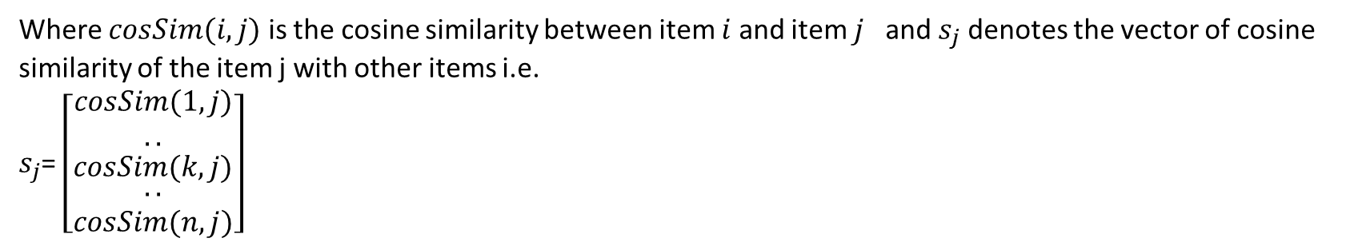
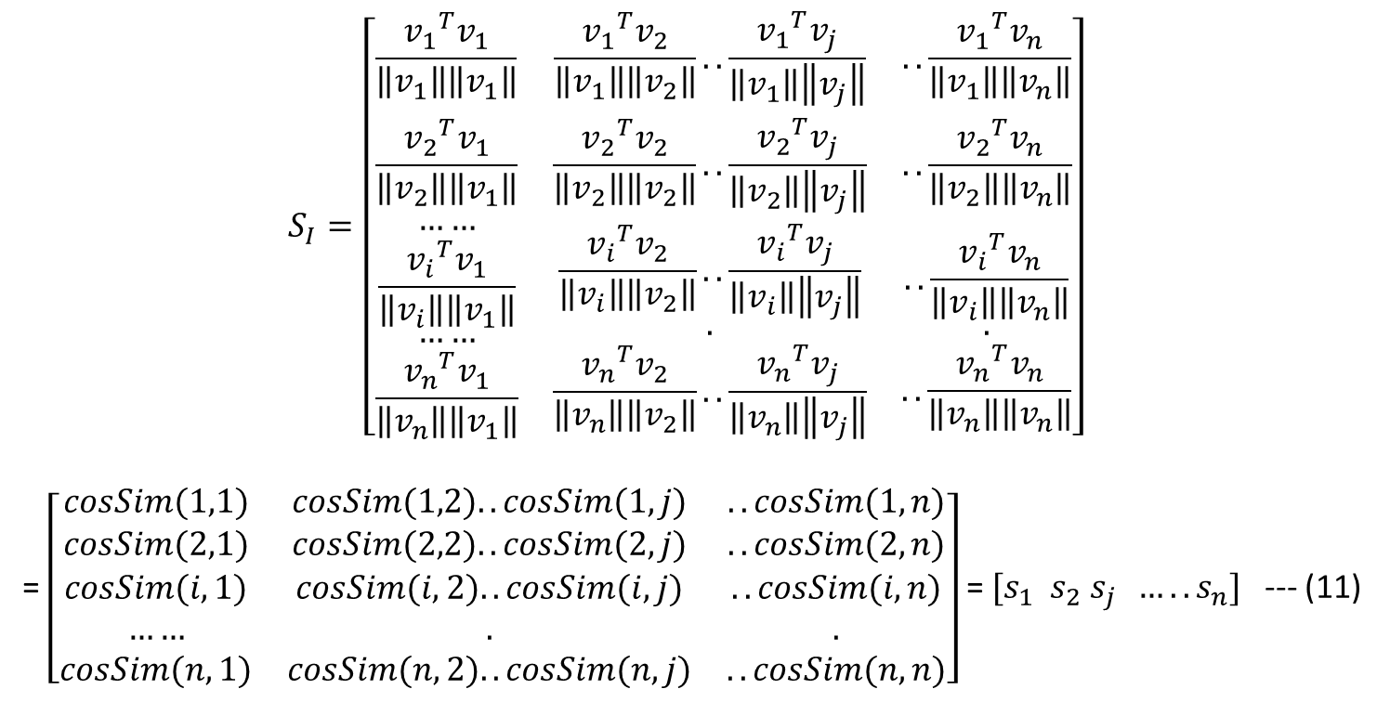
$$S_{I}=\left[\begin{matrix}\frac{{v_{1}}^{T}v_{1}}{\left\|v_{1}\right\|\left\|v_{1}\right\|} & \frac{{v_{1}}^{T}v_{2}}{\left\|v_{1}\right\|\left\|v_{2}\right\|}..\frac{{v_{1}}^{T}v_{j}}{\left\|v_{1}\right\|\left\|v_{j}\right\|} & ..\frac{{v_{1}}^{T}v_{n}}{\left\|v_{1}\right\|\left\|v_{n}\right\|} \\ \frac{{v_{2}}^{T}v_{1}}{\left\|v_{2}\right\|\left\|v_{1}\right\|} & \frac{{v_{2}}^{T}v_{2}}{\left\|v_{2}\right\|\left\|v_{2}\right\|}..\frac{{v_{2}}^{T}v_{j}}{\left\|v_{2}\right\|\left\|v_{j}\right\|} & ..\frac{{v_{2}}^{T}v_{n}}{\left\|v_{2}\right\|\left\|v_{n}\right\|} \\ \begin{aligned}\begin{aligned}…… \\ \frac{{v_{i}}^{T}v_{1}}{\left\|v_{i}\right\|\left\|v_{1}\right\|}\end{aligned} \\ …… \\ \frac{{v_{n}}^{T}v_{1}}{\left\|v_{n}\right\|\left\|v_{1}\right\|}\end{aligned} & \begin{aligned}\frac{{v_{i}}^{T}v_{2}}{\left\|v_{i}\right\|\left\|v_{2}\right\|}..\frac{{v_{i}}^{T}v_{j}}{\left\|v_{i}\right\|\left\|v_{j}\right\|} \\ . \\ \frac{{v_{n}}^{T}v_{2}}{\left\|v_{n}\right\|\left\|v_{2}\right\|}..\frac{{v_{n}}^{T}v_{j}}{\left\|v_{n}\right\|\left\|v_{j}\right\|}\end{aligned} & \begin{aligned}..\frac{{v_{i}}^{T}v_{n}}{\left\|v_{i}\right\|\left\|v_{n}\right\|} \\ . \\ ..\frac{{v_{n}}^{T}v_{n}}{\left\|v_{n}\right\|\left\|v_{n}\right\|}\end{aligned}\end{matrix}\right]$$
= $\left[\begin{matrix}cosSim(1,1) & cosSim(1,2)..cosSim(1,j) & ..cosSim(1,n) \\ cosSim(2,1) & cosSim(2,2)..cosSim(2,j) & ..cosSim(2,n) \\ \begin{aligned}cosSim(i,1) \\ …… \\ cosSim(n,1)\end{aligned} & \begin{aligned}cosSim(i,2)..cosSim(i,j) \\ . \\ cosSim(n,2)..cosSim(n,j)\end{aligned} & \begin{aligned}..cosSim(i,n) \\ . \\ ..cosSim(n,n)\end{aligned}\end{matrix}\right]$ = $[s_{1}{ s}_{2}$ $s_{j} …..s_{n}]$ --- (11)
Where $cosSim(i,j)$ is the cosine similarity between item $i$ and item $j$ and $s_{j}$ denotes the vector of cosine similarity of the item j with other items i.e.
$s_{j}$= $\left[\begin{matrix}\begin{aligned}cosSim(1,j) \\ ..\end{aligned} \\ cosSim(k,j) \\ \begin{aligned}.. \\ cosSim(n,j)\end{aligned}\end{matrix}\right]$

Slide 12
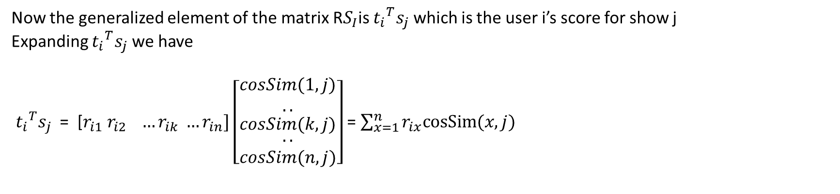
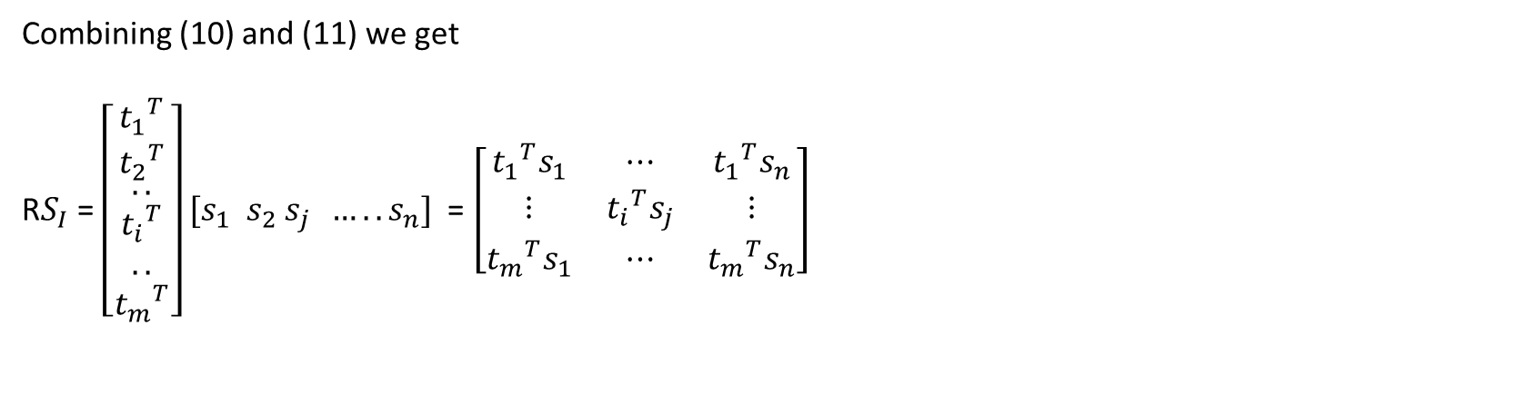
Combining (10) and (11) we get
${\text{R}S}_{I}$ = $\left[\begin{matrix}{t_{1}}^{T} \\ {t_{2}}^{T} \\ \begin{aligned}.. \\ {t_{i}}^{T} \\ .. \\ {t_{m}}^{T}\end{aligned}\end{matrix}\right]$ $[s_{1}{ s}_{2}$ $s_{j} …..s_{n}]$ = $\left[\begin{matrix}{t_{1}}^{T}s_{1} & ⋯ & {t_{1}}^{T}s_{n} \\ ⋮ & {t_{i}}^{T}s_{j} & ⋮ \\ {t_{m}}^{T}s_{1} & ⋯ & {t_{m}}^{T}s_{n}\end{matrix}\right]$
Now the generalized element of the matrix${ \text{R}S}_{I}$is ${t_{i}}^{T}s_{j}$ which is the user i’s score for show j
Expanding ${t_{i}}^{T}s_{j}$ we have
${t_{i}}^{T}s_{j}$ = $\text{[}r_{i1} r_{i2} …r_{ik} …r_{in}]$ $\left[\begin{matrix}\begin{aligned}cosSim(1,j) \\ ..\end{aligned} \\ cosSim(k,j) \\ \begin{aligned}.. \\ cosSim(n,j)\end{aligned}\end{matrix}\right]$= $\sum_{x=1}^{n}{r_{ix}cosSim⁡(x,j)}$

Slide 13
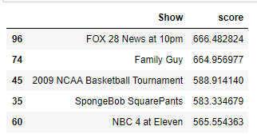
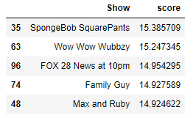
Exercise 4
Recommended movies in the 1st 100 movies for user 20 according to user similarity based recommendation score
Recommended movies in the 1st 100 movies for user 20 according to Item item similarity based recommendation score

Slide 14
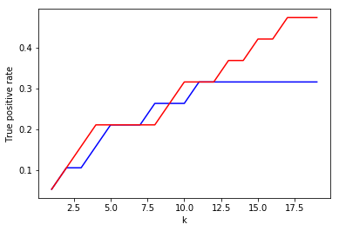
Graph of Top-K ( True positive rate vs k ) plot
Red – Item Item Recommendation Method
Blue – User User Recommendation Method

Slide 15
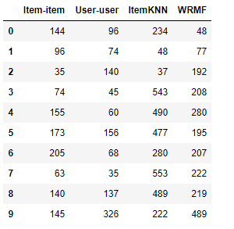
Exercise 5
ShowID | ShowName
192 | Handy Manny
195 | Imagination Movers
68 | Today
326 | 10TV Eyewitness News at 6:00
207 | Happy Monster Band
137 | 10TV Eyewitness News at 5:00
74 | Family Guy
140 | 10TV News HD at 11pm
205 | The Backyardigans
77 | Disney's Mickey Mouse Clubhouse
173 | Wonder Pets!
144 | Dora, the Explorer
145 | Go, Diego, Go!
280 | Olivia
155 | Ni Hao, Kai-Lan
156 | Seinfeld
477 | The NewsHour with Jim Lehrer
222 | Little Einsteins
543 | Sesame Street
96 | FOX 28 News at 10pm
208 | Tasty Time with ZeFronk
35 | SpongeBob SquarePants
37 | Curious George
553 | Dragon Tales
490 | Clifford the Big Red Dog
45 | 2009 NCAA Basketball Tournament
48 | Max and Ruby
219 | My Friends Tigger and Pooh
489 | Caillou
60 | NBC 4 at Eleven
234 | Jack's Big Music Show
63 | Wow Wow Wubbzy

Slide 16
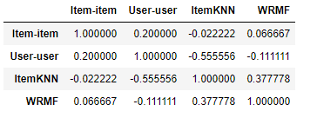

Kendal Tau correlation and Kendal tau Distances for the 4 list of recommendation
Kendal Tau correlation : ( No of concordant pairs – No of discordant pairs)/ total pairs
Kendal Tau Distance : ( No of Discordance / Total Pairs)
Item-Item User-User ItemKNN WRMF
Item-Item
User-User
ItemKNN
WRMF

